Slide 1
PC Booting-Up process
By Sagor (23124) AND
Lija(23113)

Slide 2
Presentation Outline
*Introduction
*Background
*Presentation Review
*Discussion
*Asking Question

Slide 3
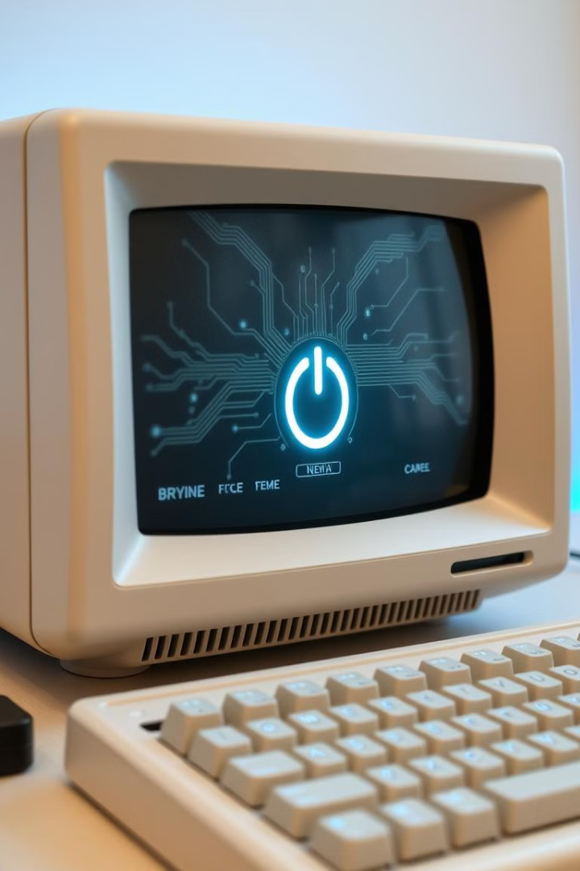
Introduction to the PC Boot-Up Process
The PC boot-up process is a crucial sequence that prepares your computer for use. It involves several steps, from powering on to user login. Understanding this process helps troubleshoot issues and optimize performance.

Slide 4
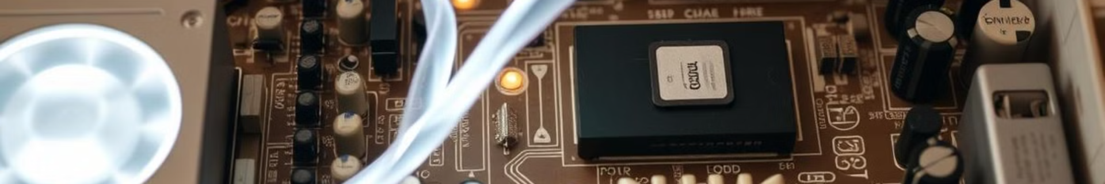
Power-On and POST
1
Power-On
Pressing the power button initiates electrical flow to all components. The system comes to life.
2
POST Begins
BIOS/UEFI firmware checks critical hardware. It ensures proper functioning of CPU, RAM, and storage.
3
Error Detection
If issues are found, POST halts the process. It may signal with beeps or error codes.

Slide 5
BIOS/UEFI Initialization
BIOS
UEFI
System Settings
Traditional firmware interface. Text-based and limited in features. Still used in older systems.
Modern firmware with graphical interface. Supports larger drives and has advanced security features.
Both load hardware configurations. They set memory timings, CPU settings, and boot order.

Slide 6
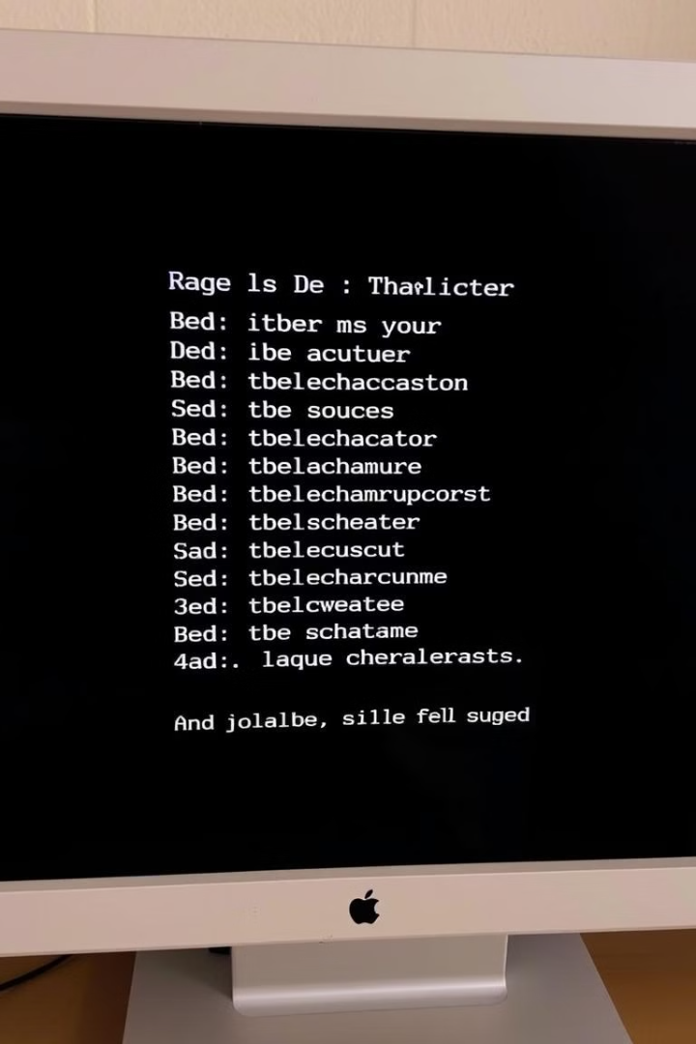
Bootloader Execution
Bootloader Role
MBR
Loads the operating system from storage. Examples include GRUB and Windows Boot Manager.
Master Boot Record. Traditional method for storing bootloader. Limited to 2TB drive sizes.
GPT
OS Selection
GUID Partition Table. Modern method supporting larger drives and more partitions.
Bootloaders can present multiple OS options if more than one is installed.

Slide 7
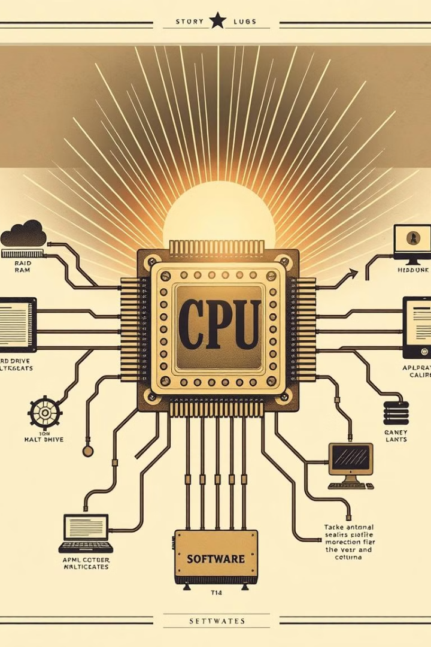



Loading the Operating System Kernel
Kernel Initialization
The core of the OS begins loading. It manages hardware-software interactions.
Driver Loading
Device drivers are initialized. They enable communication between hardware and the OS.
System Preparation
The OS loads system files and prepares the user environment.

Slide 8




User Login and System Readiness
Login Screen
User Environment
Ready for Use
The OS displays a login prompt or automatically opens the user interface.
Background services, applications, and user settings are loaded.
The computer is fully operational, completing the boot process.

Slide 9
I tried to say that in my presentation and thank you all the patience……

